Slide 1
Communication
Buses

Slide 2
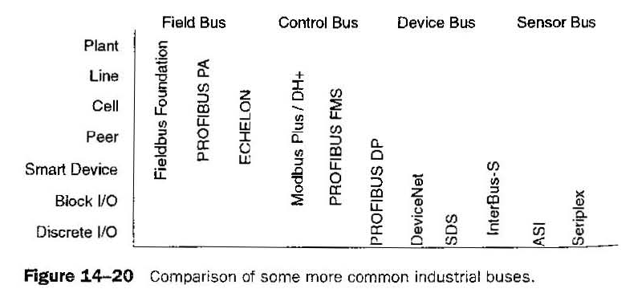
Comparison of some industrial buses

Slide 3
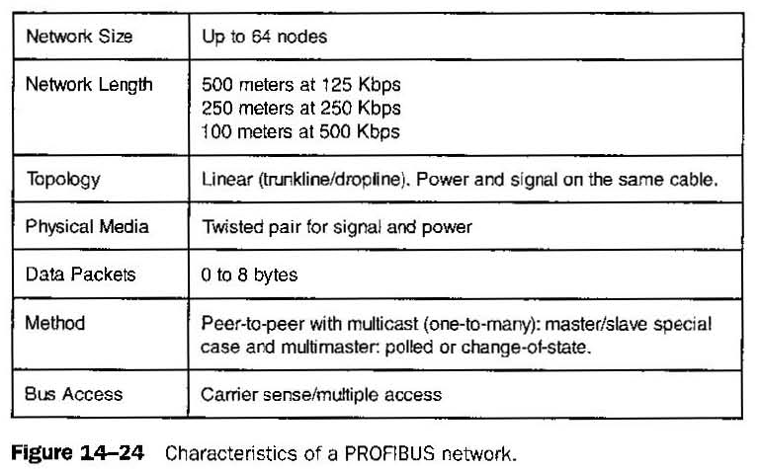
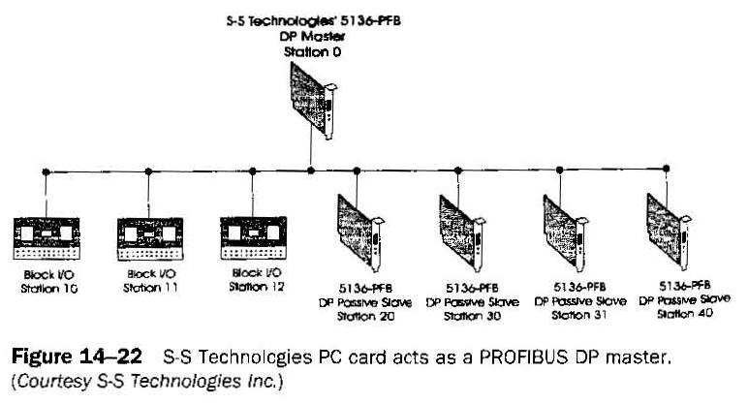
PROFIBUS (Process Field Bus)
Supports high-speed applications in discrete manufacturing such as motor starters, actuators. cell control, and remote I/O. Slaves can respond only to received messages or send messages at the master's request. Master devices have the capability to control the bus.

Slide 4
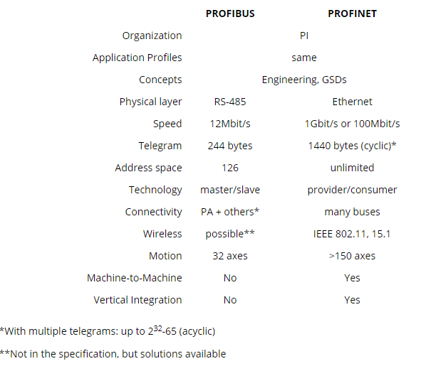
PROFINET
PROFINET networks achieve speeds of 100 Mbit/s or even 1 Gbit/s and higher. The telegram size can be up to 1440 bytes, and there are no limits on the address space. Uses Ethernet instead of RS-485.

Slide 5
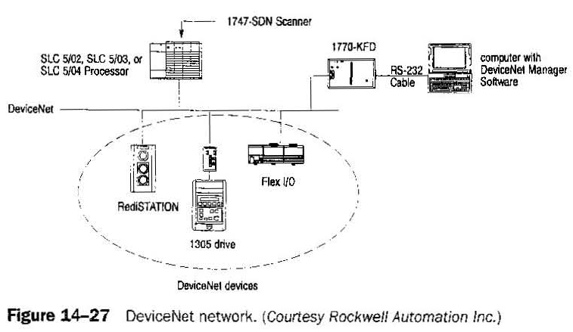
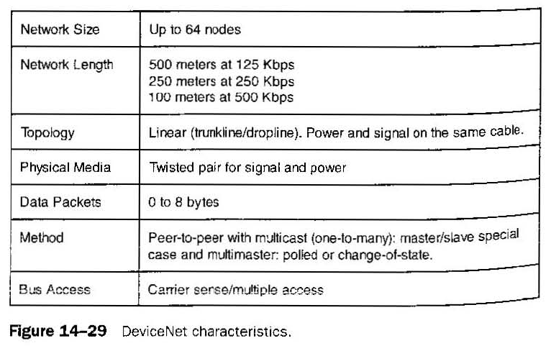
DeviceNet
DeviceNet is intended to be a low·cost method to connect sensors, switches. valves, bar code readers. drives, operator display panels. and so on to a simple network.In addition to reading the state of discrete devices, DeviceNet is able to report temperatures, to read the load current in a motor starter, to change the parameters of drives, and so on.

Slide 6
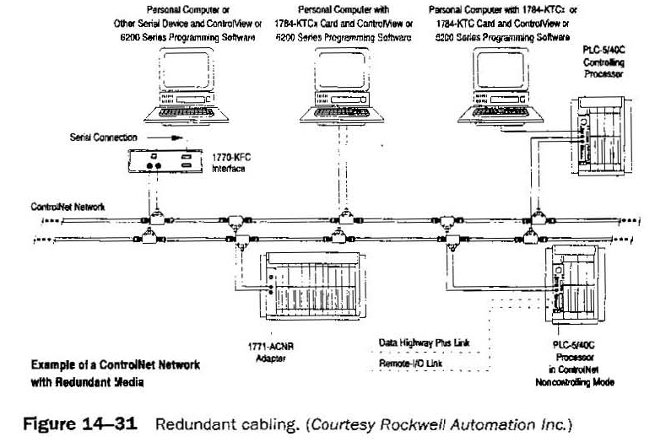
ControlNet
ControlNet is a high-speed, deterministic network developed by Allen-Bradley for transmitting critical automation and control information. Control Net can perform multiple functions including multiple PLCs, man/machine interfaces, network access by PC for programming and troubleshooting from any node.

Slide 7
Controller Area Network (CAN)
CAN was designed to be a high-integrity serial data communications bus for real-lime applications, usually for automotive.
CAN was designed to be a high-integrity serial data communications bus for real-time applications.
Data messages transmitted from a node on a CAN bus do not contain addresses of either the transmitting node or of any intended receiving node. Every node on the network receives each message and performs an acceptance test on the identifier to determine whether the message is relevant to it. If the message is relevant. the node processes it; otherwise it ignores it.
The node identifier also determines the priority of a message. The lower the numerical value of the identifier, the higher the priority.

Slide 8
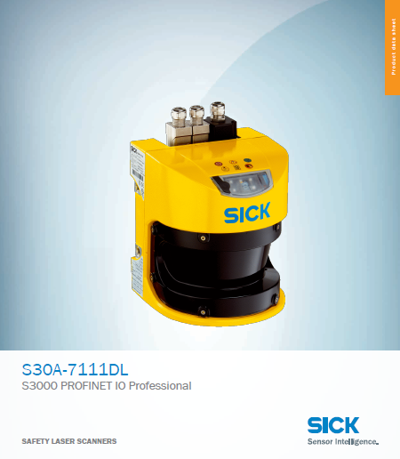
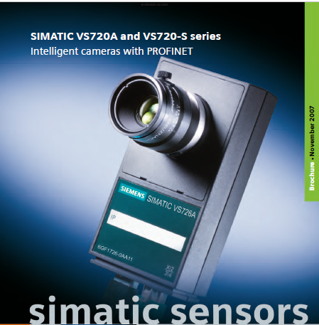
Examples for Real Time Application

